Slide 1
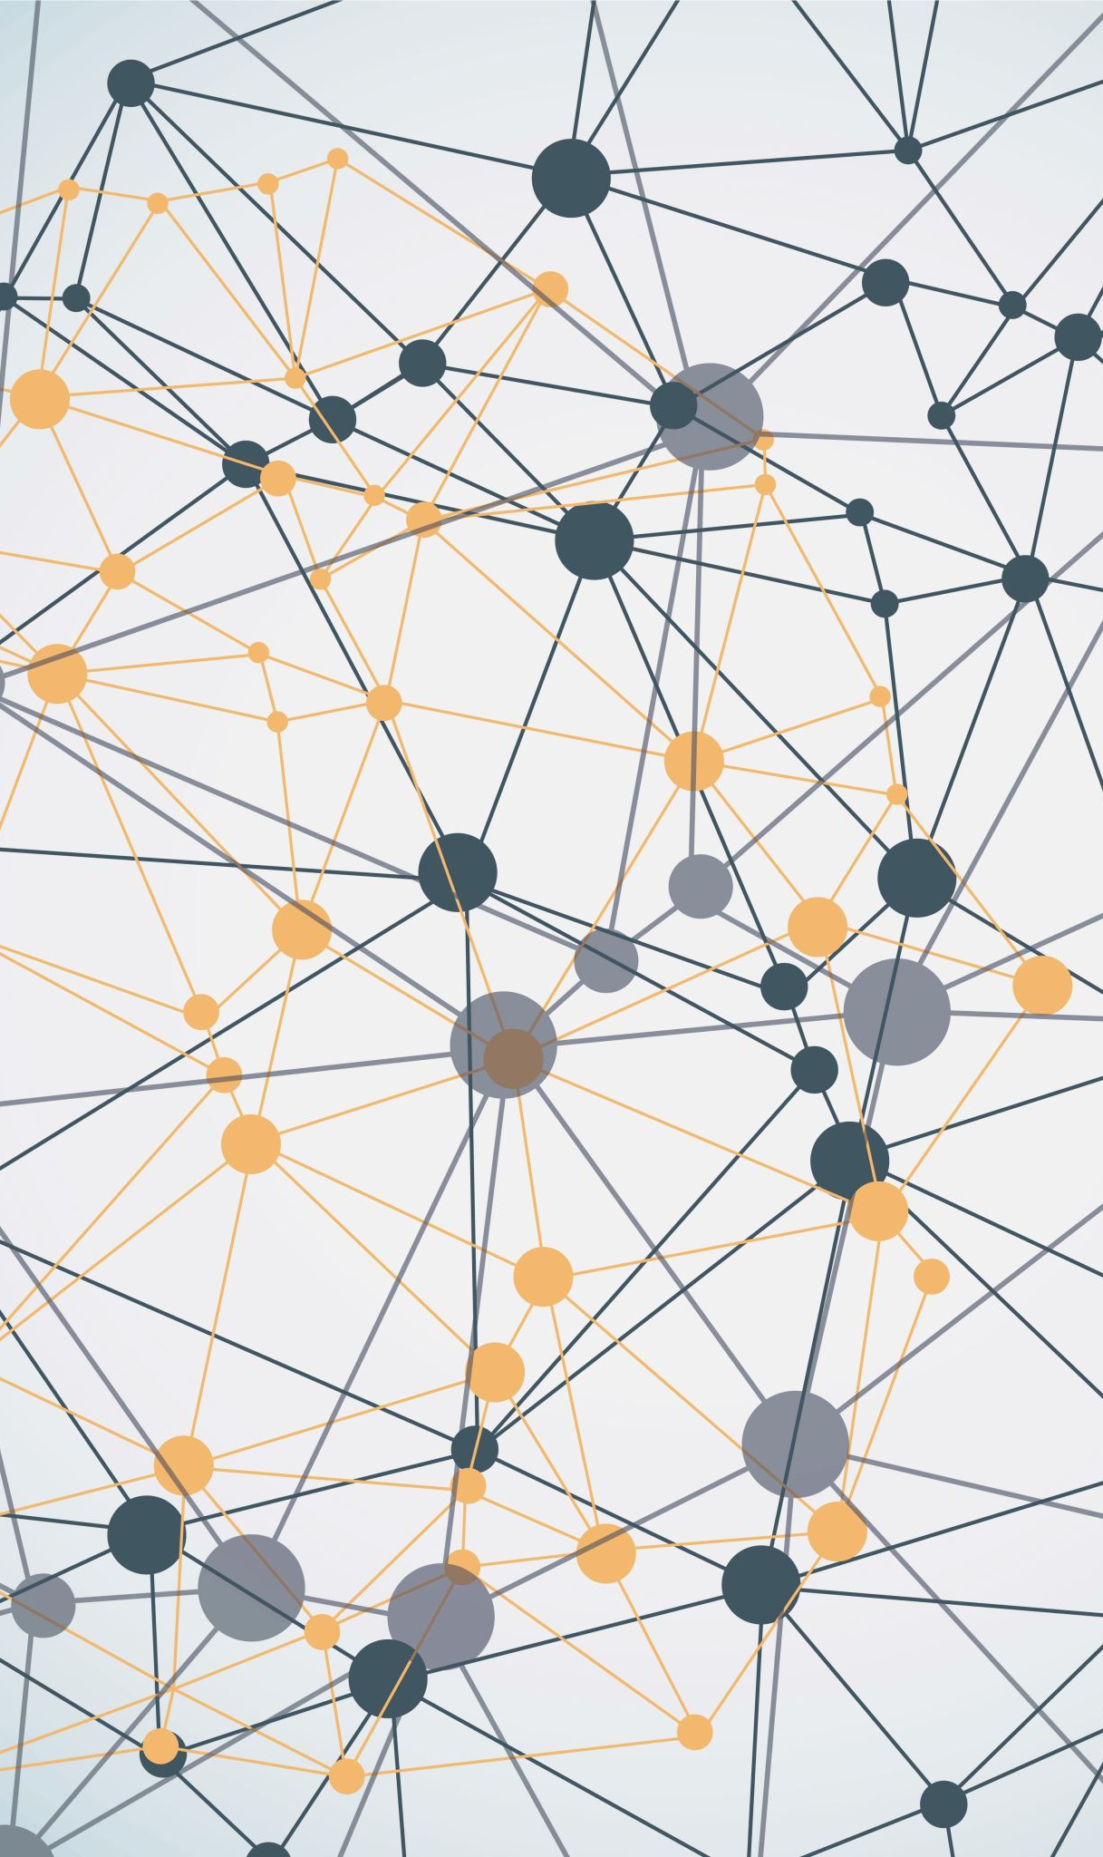
The role of remote Photoplethysmography in Musical Biofeedback Systems for Stress Reduction and Consciousness Regulation
Univers Condensed
Fabian Winkelmann
Student ID: 1284247

Slide 2
Structure
Univers Condensed
Introduction
Stress
Remote Photoplethysmography
Musical Biofeedback
Regeneration and Consciousness Regulation
Case Studies
Conclusion

Slide 3
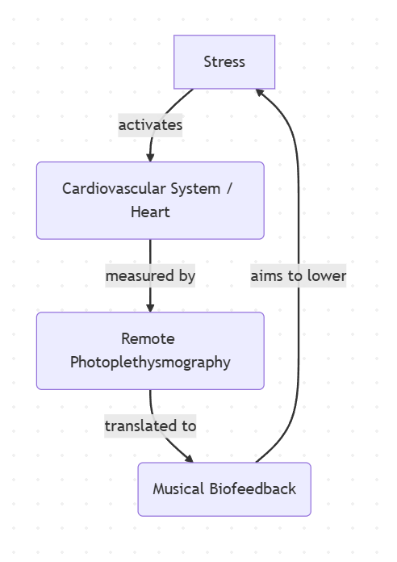
Introduction
Stress changes the heart rate¹
Plethysmography: Measurement of pulse waves²
Photoplethysmography (PPG): ... using light reflectance²
remote PPG (rPPG): … via digital camera (contactless)²
Biofeedback: Real-time loop returning physiological data³
Musical Biofeedback: Auditory feedback loop using music³
[1] cf. Mcewen2017neurobiology, [2] cf. verkruysse2008remote, [3] cf. giggins2013biofeedback
Musical Biofeedback Loop: Real-time translation of physiological rPPG data into intuitive musical biofeedback
Source: Own illustration

Slide 4
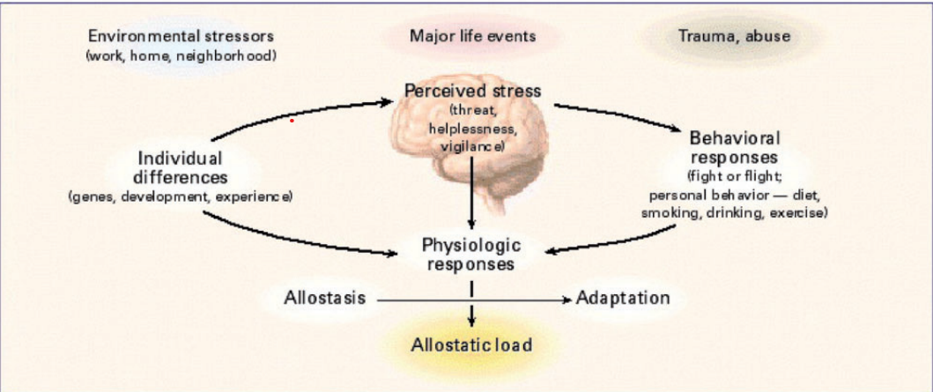
Stress
Protective Response: Short-term mobilization is a vital survival mechanism¹
Maladaptive Coping: Harmless situations trigger stress, leading to harmful habits (smoking, drinking)¹
Heart Rate (HR): Beats per minute – represents the quantity of heart activity²
Heart Rate Variability (HRV): Time variation between consecutive beats – represents the quality of heart activity²
The figure illustrates the separate components that the brain takes into account when releasing stress¹
[1] cf. Mcewen2017neurobiology [2] cf. shaffer2017overview

Slide 5
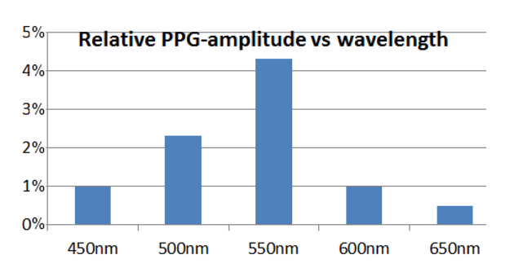
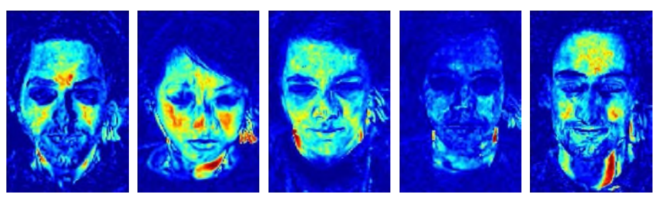
Remote Photoplethysmography (foundation)
Absorption: Blood volume changes modulate light absorption with each beat²
Green Channel: Provides the strongest signal²
Target Areas: Cheeks offer the highest signal-to-noise ratio: easily accessible, exposed³
Spectral sensitivity of the PPG signal. Green light exhibits the highest amplitude, making it the most reliable channel for non-contact heart rate monitoring.¹
[1] cf. dehaan2013chrom, [2] verkruysse2008remote,
[3] cf. lempe2013roi
The quality of the rPPG signal in the face. Blue shows low activity and red high activity³

Slide 6
Remote Photoplethysmography (Signal extraction overview)
Blind Source Separation
Separation of pulse and noise based on statistical independence¹
Physics based Models (CHROM)
Principle: uses skin-light-reflection properties for robust real-time tracking²
Deep Learning Models
Principle: Uses neural networks high accuracy³
[1] cf. poh2010non, [2] cf. dehaan2013chrom [3] cf. Debnath25

Slide 7
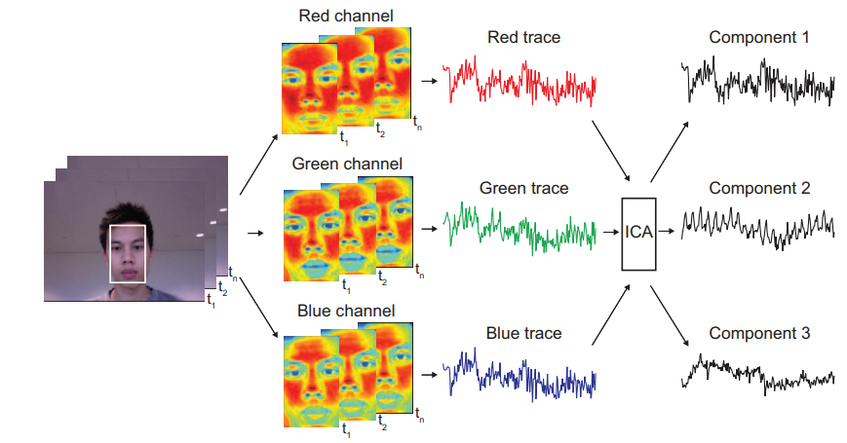
Remote Photoplethysmography (Blind Source Separation)
Signal Mixture: The camera image as a mixture of independent sources (Pulse, Light, Motion)¹
Mathematical Tool: Uses algorithms like JADE to separate the signals¹
Signal Refinement (Filtering)¹
Bandpass Limit: Restrict data to 45-240BPM
Fast Fourier Transform Analysis: find the strongest periodic frequency (the Heart rate)
Outlier Rejection: Prevents unrealistic jumps
Limitation¹:
Component Misidentification: In extreme light or motion, the wrong signal (light instead of pulse) is picked
Requires a long data window (30 seconds)
Separating independent sources from raw skin color channels (RGB) using the JADE algorithm for rPPG¹
[1] cf. poh2010non

Slide 8
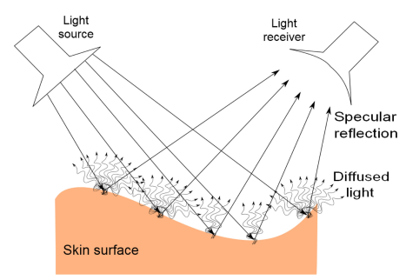
Remote Photoplethysmography (CHROM)
Physicsbased alternative: Chrominance-based method¹
Camera sees:¹
Intensity: Brightness of light
Specular Reflection: Mirror-like glare on the surface
Static Skin Color: The constant tissue color
2D-Projection RGB signals are projected onto a plane perpendicular to the standard skin tone ¹
Noise cancellation: A clean, movement-robust pulse signal¹
Bandpass Filtering (0.7-4.0Hz) -> matching the human heart rate (42-240BPM)¹
Fast Fourier Transform: Identifies the strongest periodic signal to determine the heart rate¹
The illustration depicts light reflection on the skin ¹
[1] cf. dehaan2013chrom

Slide 9
Remote Photoplethysmography (CHROM)
Accuracy 98 % in stable conditions, 92 % correlation with medical sensors (ground truth)¹
The "Motion" Advantage: Maintains a 48% success rate under heavy movement – where BSS models drop to a failing 4-11%¹
Low latency: Only 1.6s (vs 30s with BSS)¹
Diversity: Robust performance across all skin tones¹
[1] cf. dehaan2013chrom

Slide 10
Remote Photoplethysmography (Deep Learning Models)
Transition to End-to-End Deep Learning Models¹
Fully automated: No manual Face/ROI selection required¹
Data challenges:¹
Significant lack of large-scale, high-quality datasets
Underrepresentation of diverse age groups and skin pigmentations
Mobile Optimization: Ongoing research into lightweight models for real-time deployment on smartphone hardware¹
[1] cf. Debnath25

Slide 11
Musical Biofeedback
Ecological Perception:¹
Uses natural associations (e.g. distance) to represent intensity
Example: Decreasing volume mimics a sound source moving away, making data changes intuitive
Data-to-Music Transformation:¹
direct transformation of heartbeat data into an auditory stream
Continuous parameter mapping: ensures immediate, fluid feedback of physiological changes
[1] cf. dubus2013systematic

Slide 12
Regeneration and Consciousness Regulation
Cardiovascular Synchronization¹
Resonance Frequency: Achieved at ~6 breaths per minute
Harmonic State: Heart rate and blood pressure synchronize for maximum efficiency
Optimized gas exchange in the lungs
Less strain on the cardiovascular system
Physiological Impact¹
Deep Relaxation Response in the body
The auditory signal acts as a meditative anchor
Mindfulness²
Enhances sensitivity to thoughts and emotional states
Promotes an attitude of curiosity, openness and acceptance
Helps to perceive the internal state without judgement
[1] cf. lehrer2014heart, [2] cf. bishop2004mindfulness

Slide 13
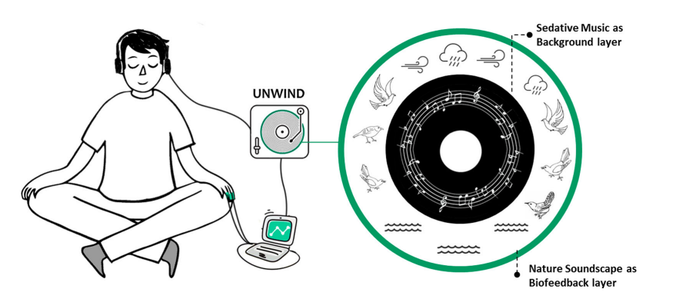
Case Studies (Unwind System)
Concept: Nature soundscapes with sedative music to guide relaxation¹
HRV Sonification¹:
Wind Mapping: Heart Rate Variability (HRV) is mapped to wind sounds
Users adapt their breathing to transform the wind into a smooth, consistent sine wave
Adaptive Soundscape¹:
LOW HRV (Stress): Environment becomes busy and complex
High HRV (Relaxed): Soundscape becomes simple, transparent and calm
The illustration depicts the feedback loop of the Unwind System¹
[1] cf. yu2018unwind

Slide 14
Case Studies (Unwind System)
Key Results:¹
Significant reduction in both heart rate and respiration rate in comparison to the control group
70% of participants used the nature sounds to visualize scenes, significantly improving focus and immersion.
The illustration depicts the feedback loop of the Unwind System¹
[1] cf. yu2018unwind

Slide 15
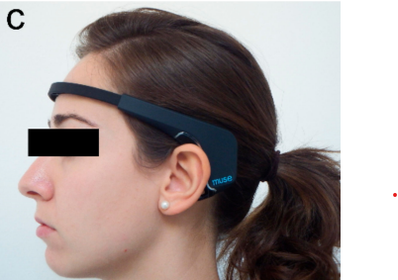
Case Studies (MuseTM Headband )
The concept: Lowering the entry barrier for meditation through real-time brainwave measurement¹
Daily attention training with feedback through smartphone app¹
Key Findings:¹
Stress Reduction: The experimental group recorded a 7% decrease after 2 weeks and 14% after 4 weeks
Mental Performance: Improved concentration levels and superior impulse control during complex tasks
Control Group: Showed no significant changes in stress or performance levels
Real-time feedback is the decisive factor¹
Subject wearing the Muse™ EEG headband during a neurofeedback session.¹
[1] cf. app7121280

Slide 16
Conclusion
The Core Metric: Heart Rate Variability (HRV)¹
HRV provides significantly deeper physiological insights than simple Heart Rate (BPM)
Technical Strategy: ²
Choosing CHROM for its computational efficiency and real-time capabilities
The Competitive Edge:
Unlike Blind Source Separation³, CHROM requires shorter observation windows and effectively identifies the correct color channels ²
Superior to Deep Learning: CHROM is robust against noise without the massive resource intensity or dataset bias of AI models⁴
Musical Biofeedback Loop: Real-time translation of physiological rPPG data into intuitive musical biofeedback
Source: Own illustration
[1] cf. shaffer2017overview, [2] dehaan2013chrom, [3] cf. poh2010non, [4] cf. Debnath25

Slide 17
Conclusion
The mapping Process¹:
Continuous Mapping: instant, fluid audio stream
Sound Design: Calm State = Calm Sound – non intrusive soundscapes to reinforce relaxation
Evidence-Based Systems:
Unwind System: uses nature sounds for feedback²
Muse™: uses real-time loops to increase stress awareness and control³
Musical Biofeedback Loop: Real-time translation of physiological rPPG data into intuitive musical biofeedback
Source: Own illustration
[1] cf. dubus2013systematic [2] cf. yu2018unwind [3] cf. app7121280

Slide 18
https://medium.com/@zurister/depth-wise-convolution-and-depth-wise-separable-convolution-37346565d4ec
Future Outlook
Potential: Monitor stress at work (office)
Trend: Small AI models for laptops or mobiles
Efficiency: Cost-effective (simple camera)
Privacy: High risk! Local processing only (No Cloud)

Slide 19
https://medium.com/@zurister/depth-wise-convolution-and-depth-wise-separable-convolution-37346565d4ec
References
Identifier | Referenz
Mcewen2017neurobiology | B. S. McEwen, “Neurobiological and systemic effects of chronic stress,” Chronic Stress, vol. 1, p. 2470547017692328, 2017.
giggins2013biofeedback | O. M. Giggins, U. M. Persson, and B. Caulfield, “Biofeedback in rehabilitation,” Journal of Neuro Engineering and Rehabilitation, vol. 10, no. 1, p. 60, 2013
verkruysse2008remote | W. Verkruysse, L. O. Svaasand, and J. S. Nelson, “Remote plethysmographic imaging using ambient light,” Optics Express, vol. 16,no. 26, pp. 21 466–21 475, 2008
shaffer2017overview | F. Shaffer and J. Ginsberg, “An overview of heart rate variability metrics and norms,” Frontiers in Public Health, vol. 5, p. 258, 2017.

Slide 20
https://medium.com/@zurister/depth-wise-convolution-and-depth-wise-separable-convolution-37346565d4ec
Identifier | Referenz
dehaan2013chrom | U. Debnath and S. Kim, “A comprehensive review of heartrate measurement using remote photoplethysmography and deep learning,” BioMedical Engineering OnLine, vol. 24, no. 1, p. 73, 2025.
lehrer2014heart | P. M. Lehrer and R. Gevirtz, “Heart rate variability biofeedback:how and why does it work?” Frontiers in Psychology, vol. 5, p. 756,2014.
bishop2004mindfulness | S. R. Bishop, M. Lau, S. Shapiro, L. Carlson, N. D. Anderson,J. Carmody, Z. V. Segal, S. Abbey, M. Speca, D. Velting et al., “Mindfulness: A proposed operational definition,” Clinical Psychology:Science and Practice, vol. 11, no. 3, pp. 230–241, 2004.

Slide 21
https://medium.com/@zurister/depth-wise-convolution-and-depth-wise-separable-convolution-37346565d4ec
Identifier | Referenz
app7121280 | M. Balconi, D. Crivelli, G. Fronda, and I. Venturella, “Conscious, pre-conscious and unconscious mechanisms in emotional behaviour. some applications to the mindfulness approach withwearable devices,” Applied Sciences, vol. 7, no. 12, 2017. [Online].Available: https://www.mdpi.com/2076-3417/7/12/1280
yu2018unwind | B. Yu, M. Funk, J. Hu, and L. Feijs, “Unwind: a musical biofeedback for relaxation assistance,” Behaviour & Information Technology, vol. 37, no. 8, pp. 800–814, 2018. [Online]. Available: https://doi.org/10.1080/0144929X.2018.1484515
dubus2013systematic | G. Dubus and R. Bresin, “A systematic review of mapping strategies for the sonification of physical quantities,” PLoS ONE, vol. 8,no. 12, p. e82491, 2013
poh2010non | M.-Z. Poh, D. J. McDuff, and R. W. Picard, “Non-contact, automated cardiac pulse measurements using video imaging andblind source separation,” Optics Express, vol. 18, no. 10, pp. 10 762–10 774, 2010.

Slide 22
https://medium.com/@zurister/depth-wise-convolution-and-depth-wise-separable-convolution-37346565d4ec
Identifier | Referenz
lempe2013roi | G. Lempe, S. Zaunseder, T. Wirth, S. Eck, and H. Malberg, “Roi selection for remote photoplethysmography,” in 2013 International Conference on Information Technology and Applications in Biomedicine(ITAB). IEEE, 2013, pp. 1–4.
Debnath25 | U. Debnath and S. Kim, “A comprehensive review of heartrate measurement using remote photoplethysmography and deep learning,” BioMedical Engineering OnLine, vol. 24, no. 1, p. 73, 2025

